Slide 1

Computer Networks
Computer networks Models
TCP / OSI

Slide 2
Topic of the day
Network Models
OSI Model Layers
TCP/IP Model Layers
TCP/IP vs OSI Model

Slide 3
Layered Architecture
Peer to Peer Processes
Interfaces between Layers
Encapsulation

Slide 4
Layered Architecture
The OSI model is composed of seven ordered layers: physical (layer 1), data link (layer 2), network (layer 3), transport (layer 4), session (layer 5), presentation (layer 6), and application (layer 7).
As the message travels from A to B, it may pass through many intermediate nodes.
These intermediate nodes usually involve only the first three layers of the OSI model.
Each layer defines a family of functions distinct from those of the other layers.
Within a single machine, each layer calls upon the services of the layer just below it.
This communication is governed by an agreed-upon series of rules and conventions called protocols.

Slide 5
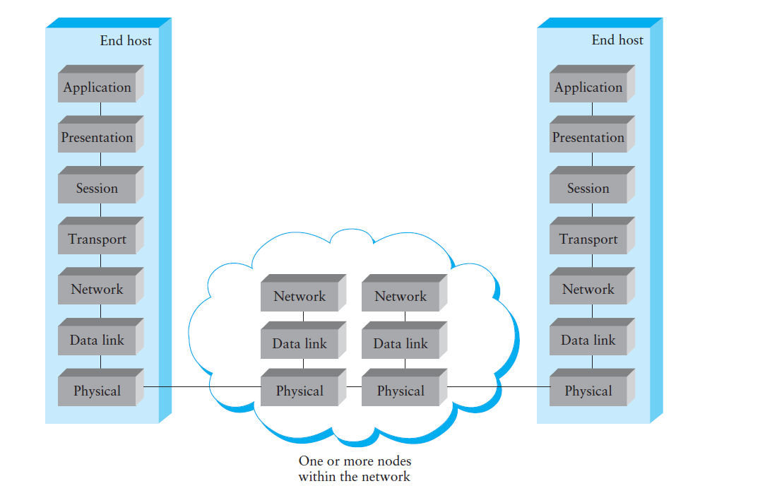

Slide 6
7 Layers of the OSI Model
Layer | Responsible For:
7.) Application | Provides Services to User Apps
6.) Presentation | Data Representation
5.) Session | Communication Between Hosts
4.) Transport | Flow Ctrl, Error Detection/Correction
3.) Network | End to End Delivery, Logical Addr
2.) Data Link | Media Access Ctrl, Physical Addr
1.) Physical | Medium, Interfaces, Puts Bits on Med.

Slide 7
Examples
Layer | Example
7.) Application | HTTP, FTP, SMTP
6.) Presentation | ASCII, JPEG, PGP
5.) Session | BOOTP, NetBIOS, DHCP, DNS
4.) Transport | TCP, UDP, SPX
3.) Network | IP, IPX, ICMP
2.) Data Link | Ethernet, Token Ring, Frame Relay
1.) Physical | Bits, Interfaces, Hubs

Slide 8
Peer to Peer Processes
The processes on each machine that communicate at a given layer are called peer-to-peer processes.
Communication between machines is therefore a peer-to-peer process using the protocols appropriate to a given layer.
Each layer in the sending device adds its own information to the message it receives from the layer just above it and passes the whole package to the layer just below it.
Notes:
Processes interact with the processes at peer layer only

Slide 10
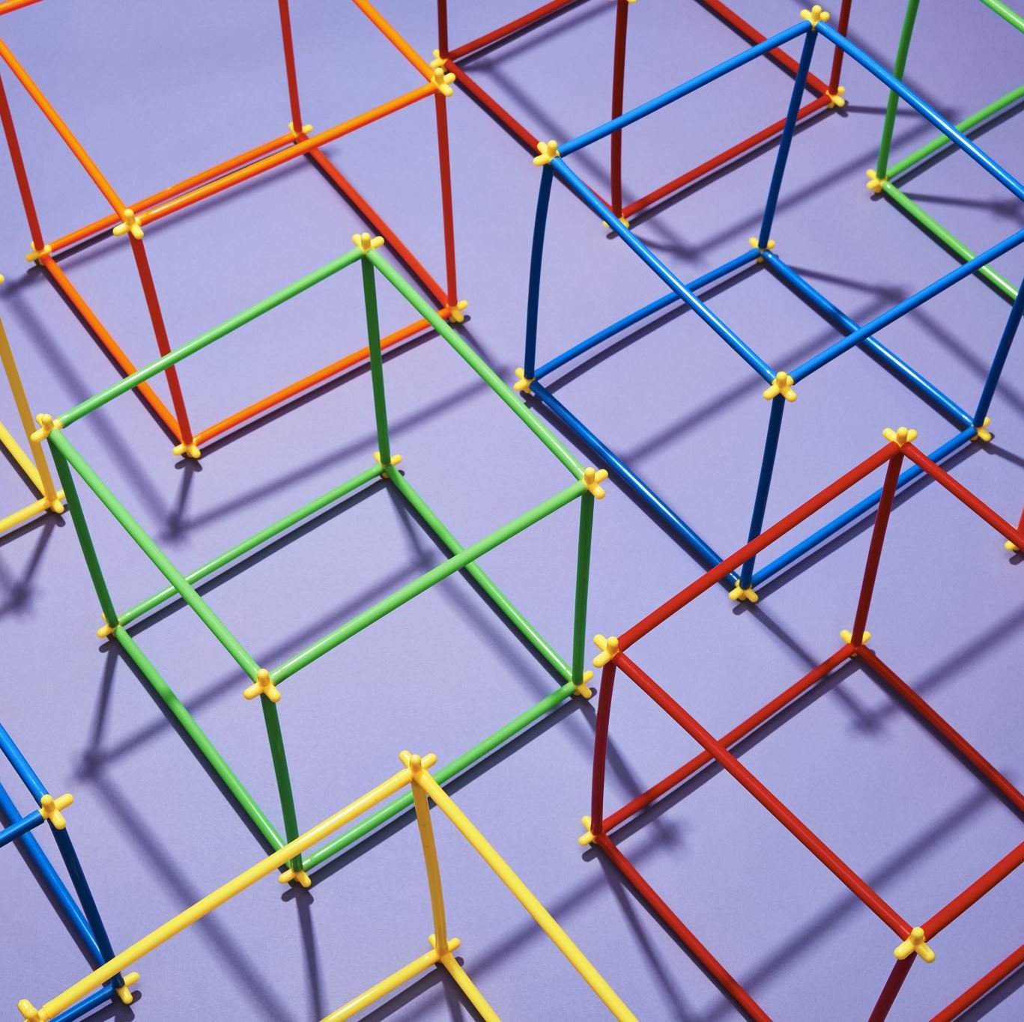
Interfaces between the Layers
The passing of the data and network information down through the layers of the sending device and back up through the layers of the receiving device is made possible
Interface between each pair of adjacent layers.
Defines the information and services a layer must provide for the layer above it.
Well-defined interfaces and layer functions provide modularity to a network.
As long as a layer provides the expected services to the layer above it, the specific implementation of its functions can be modified or replaced without requiring changes to the surrounding layers.

Slide 11
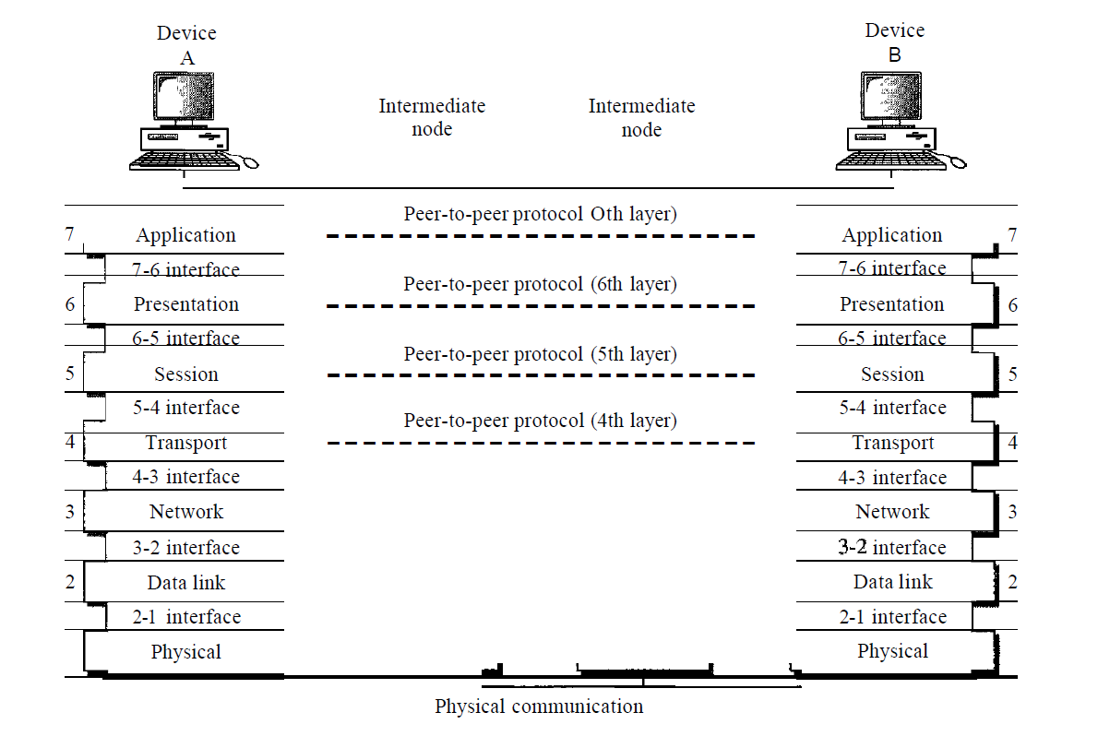

Slide 13
Layer 1 – Physical Layer
Coordinates the functions required to carry a bit stream over a physical medium.
Deals with the mechanical and electrical specifications of the interface and transmission medium.
Also defines the procedures and functions that physical devices and interfaces have to perform for transmission to occur.
Provides services to the upper layer(data link layer).
The physical layer is responsible for movements of individual bits from one hop (node) to the next.

Slide 14
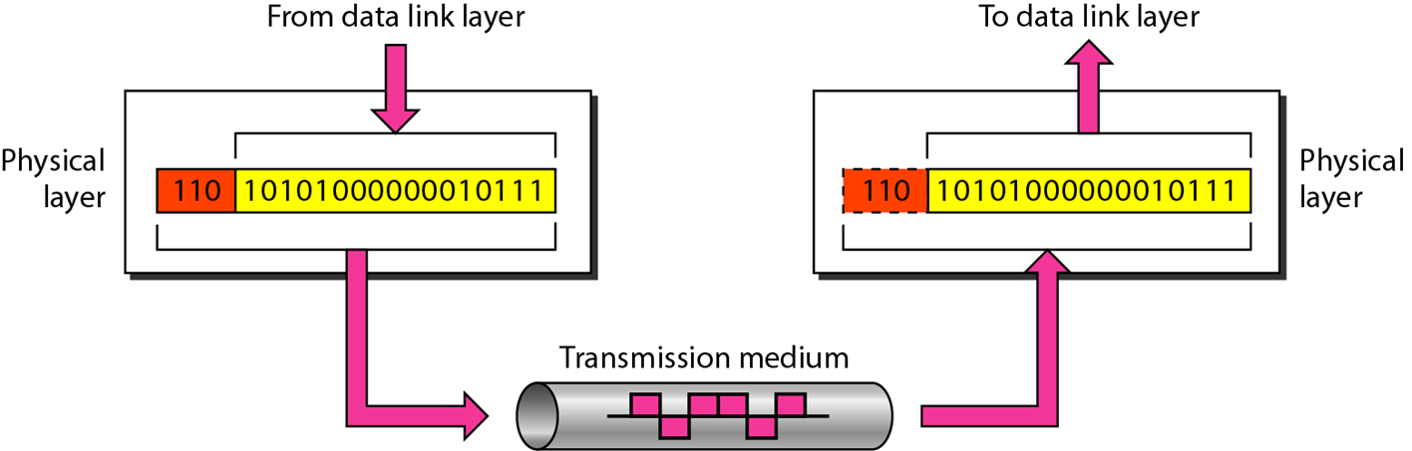

Slide 15
Physical characteristics of interfaces and medium: Interface between the devices and the transmission medium. It also defines the type of transmission medium.
Representation of bits: The physical layer data consists of a stream of bits sequence of (0s or 1s) with no interpretation. To be transmitted, bits must be encoded into signals--electrical or optical. Defines the type of encoding.
Data rate: The transmission rate-the number of bits sent each second.
Synchronization of bits: The sender and receiver not only must use the same bit rate but also must be synchronized at the bit level. In other words, the sender and the receiver clocks must be synchronized.
Line configuration: concerned with the connection of devices to the media (point-to-point, multipoint).
Physical topology: The physical topology defines how devices are connected to make a network. mesh topology, a star topology , a ring topology, a bus topology or a hybrid topology.
Transmission mode: The physical layer also defines the direction of transmission between two devices: simplex, half-duplex, or full-duplex.

Slide 16
Layer 2 – Data Link Layer
The data link layer transforms the physical layer, a raw transmission facility, to a reliable link.
It makes the physical layer appear error free to the upper layer (network layer).
The data link layer is responsible for moving frames from one hop (node) to the next.

Slide 17
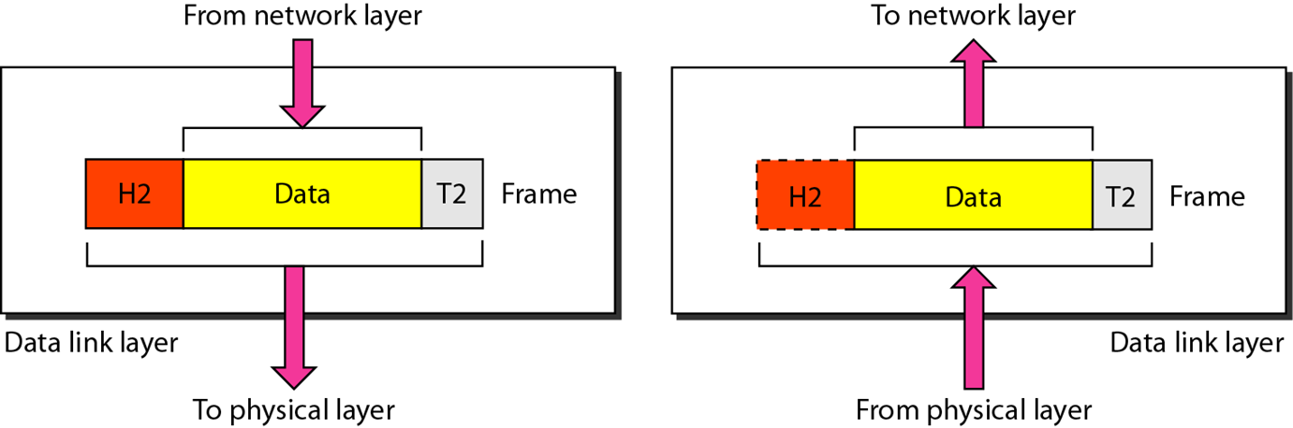

Slide 18
Framing: Divides the stream of bits received from the network layer into manageable data units called frames.
Physical addressing: If frames are to be distributed to different systems on the network, the data link layer adds a header to the frame to define the sender and/or receiver of the frame. If the frame is intended for a system outside the sender’s network, the receiver address is the address of the device that connects the network to the next one.
Flow control: If the rate at which the data are absorbed by the receiver is less than the rate at which data are produced in the sender, the data link layer imposes a flow control mechanism to avoid overwhelming the receiver.
Error control: Adds reliability to the physical layer by adding mechanisms to detect and retransmit damaged or lost frames. Uses a mechanism to recognize duplicate frames. Error control is normally achieved through a trailer added to the end of the frame.
Access control: When two or more devices are connected to the same link, data link layer protocols are necessary to determine which device has control over the link at any given time.

Slide 19
Layer 3 – Network Layer
The network layer is responsible for the delivery of individual packets from the source host to the destination host.
If two systems are connected to the same link, there is usually no need for a network layer. However, if the two systems are attached to different networks (links) with connecting devices between the networks (links), there is often a need for the network layer to accomplish source-to-destination delivery.

Slide 20
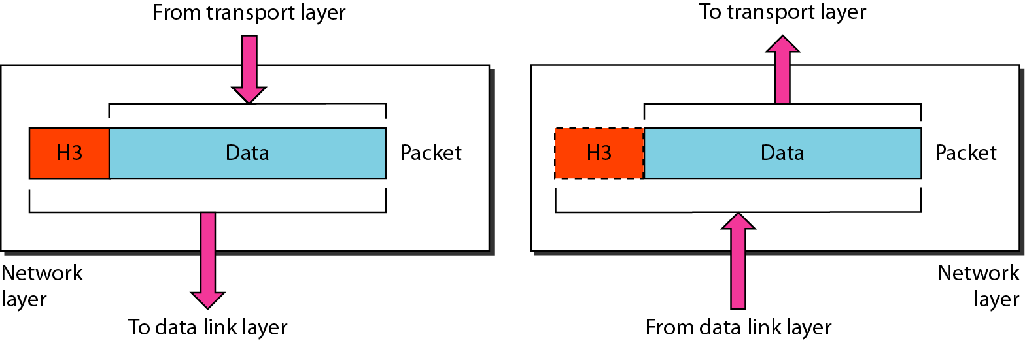

Slide 21
The network Layer controls the operation of the subnet. The main aim of this layer is to deliver packets from source to destination across multiple links (networks). If two computers (system) are connected on the same link, then there is no need for a network layer. It routes the signal through different channels to the other end and acts as a network controller.
It also divides the outgoing messages into packets and to assemble incoming packets into messages for higher levels.
In broadcast networks, the routing problem is simple, so the network layer is often thin or even non-existent.

Slide 22
It translates logical network address into physical address. Concerned with circuit, message or packet switching.
Routers and gateways operate in the network layer. Mechanism is provided by Network Layer for routing the packets to final destination.
Connection services are provided including network layer flow control, network layer error control and packet sequence control.
Breaks larger packets into small packets.
Notes:
NAT: network address translation

Slide 23
Layer 4 – Transport Layer
The transport layer is responsible for process-to-process delivery of the entire message.
A process is an application program running on a host.
Whereas the network layer oversees source-to-destination delivery of individual packets, it does not recognize any relationship between those packets. It treats each one independently, as though each piece belonged to a separate message, whether or not it does.
The transport layer, on the other hand, ensures that the whole message arrives intact and in order, overseeing both error control and flow control at the source-to-destination level.

Slide 24
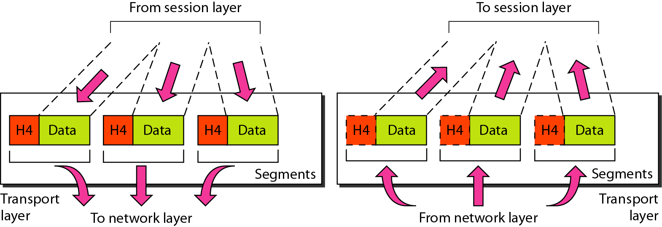

Slide 25
Service-point addressing: Source-to-destination delivery means delivery not only from one computer to the next but also from a specific process (running program) on one computer to a specific process (running program) on the other. The transport layer header must therefore include a type of address called a service-point address (or port address). The network layer gets each packet to the correct computer; the transport layer gets the entire message to the correct process on that computer.
Segmentation and reassembly: A message is divided into transmittable segments, with each segment containing a sequence number. These numbers enable the transport layer to reassemble the message correctly upon arriving at the destination and to identify and replace packets that were lost in transmission.
Connection control: The transport layer can be either connectionless(UDP) or connection oriented(TCP).
Flow control: Like the data link layer, the transport layer is responsible for flow control. However, flow control at this layer is performed end to end rather than across a single link.
Error control: Like the data link layer, the transport layer is responsible for error control. However, error control at this layer is performed process-to-process rather than across a single link. Error correction is usually achieved through retransmission.
Notes:
Connection Control:A connectionless transport layer treats each segment as an independent packet and delivers it to the transport layer at the destination machine. A connection-oriented transport layer makes a connection with the transport layer at the destination machine first before delivering the packets. After all the data are transferred, the connection is terminated.
The sending transport layer makes sure that the entire message arrives at the receiving transport layer without error (damage, loss, or duplication).

Slide 26
Layer 5 – Session Layer
The session layer is responsible for dialog control and synchronization.
The session layer is the network dialog controller.
It establishes, maintains, and synchronizes the interaction among communicating systems.

Slide 27
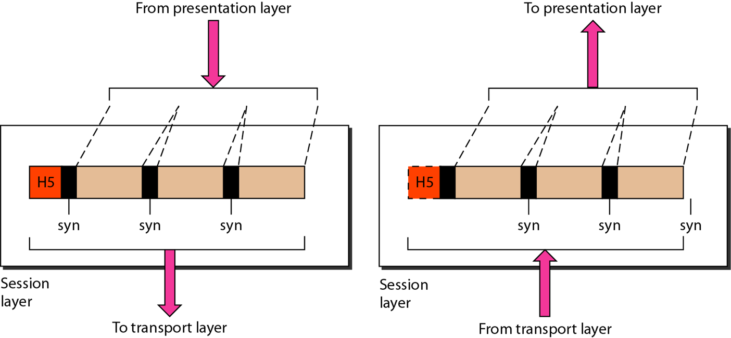

Slide 28
Dialog control: The session layer allows two systems to enter into a dialog. It allows the communication between two processes to take place in either half-duplex (one way at a time) or full-duplex (two ways at a time) mode.
Synchronization: The session layer allows a process to add checkpoints, or synchronization points, to a stream of data. For example, if a system is sending a file of 2000 pages, it is advisable to insert checkpoints after every 100 pages to ensure that each 100-page unit is received and acknowledged independently. In this case, if a crash happens during the transmission of page 523, the only pages that need to be resent after system recovery are pages 501 to 523. Pages previous to 501 need not be resent.

Slide 29
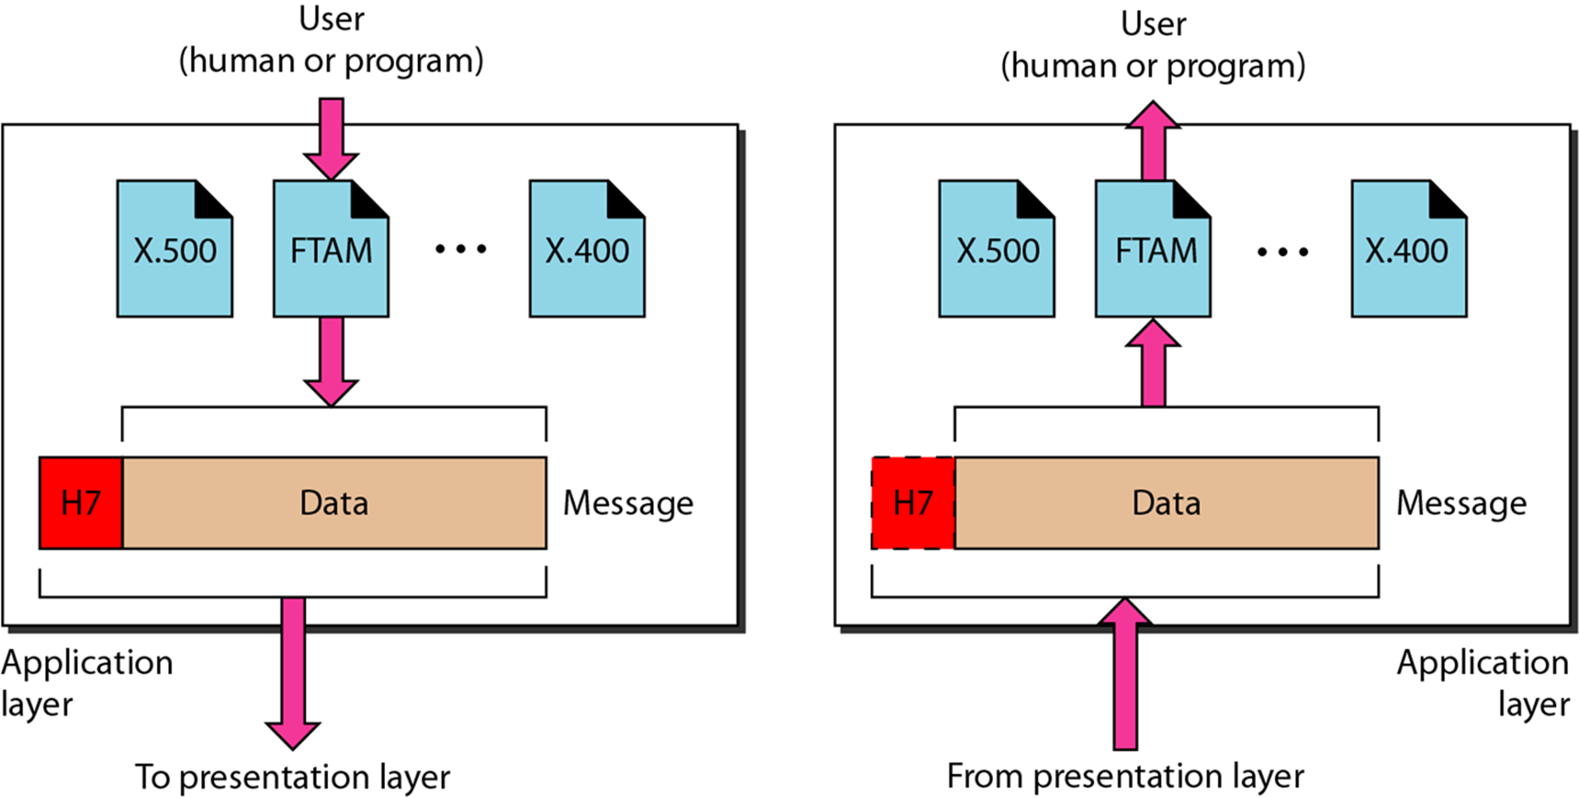
Layer 6 – Presentation Layer
The presentation layer is concerned with the syntax and semantics of the information exchanged between two systems.
Notes:
That’s why data is independent of machine and OS and application versions

Slide 30
Translation: Because different computers use different encoding systems, the presentation layer is responsible for interoperability between these different encoding methods. The presentation layer at the sender changes the information from its sender-dependent format into a common format. The presentation layer at the receiving machine changes the common format into its receiver-dependent format.
Encryption: To carry sensitive information, a system must be able to ensure privacy. Encryption means that the sender transforms the original information to another form and sends the resulting message out over the network. Decryption reverses the original process to transform the message back to its original form.
Compression: Data compression reduces the number of bits contained in the information. Data compression becomes particularly important in the transmission of multimedia such as text, audio, and video.
Notes:
That’s why data is independent of machine and OS and application versions

Slide 31
Layer 7 – Application Layer
The application layer enables the user, whether human or software, to access the network.
It provides user interfaces and support for services such as electronic mail, remote file access and transfer, shared database management, and other types of distributed information services.
The application layer is responsible for providing services to the user.

Slide 32
Network virtual terminal: A network virtual terminal is a software version of a physical terminal, and it allows a user to log on to a remote host. To do so, the application creates a software emulation of a terminal at the remote host. The user's computer talks to the software terminal which, in turn, talks to the host, and vice versa. The remote host believes it is communicating with one of its own terminals and allows the user to log on.
File transfer, access, and management: This application allows a user to access files in a remote host (to make changes or read data), to retrieve files from a remote computer for use in the local computer, and to manage or control files in a remote computer locally.
Mail services: This application provides the basis for e-mail forwarding and storage.
Directory services: This application provides distributed database sources and access for global information about various objects and services.

Slide 33
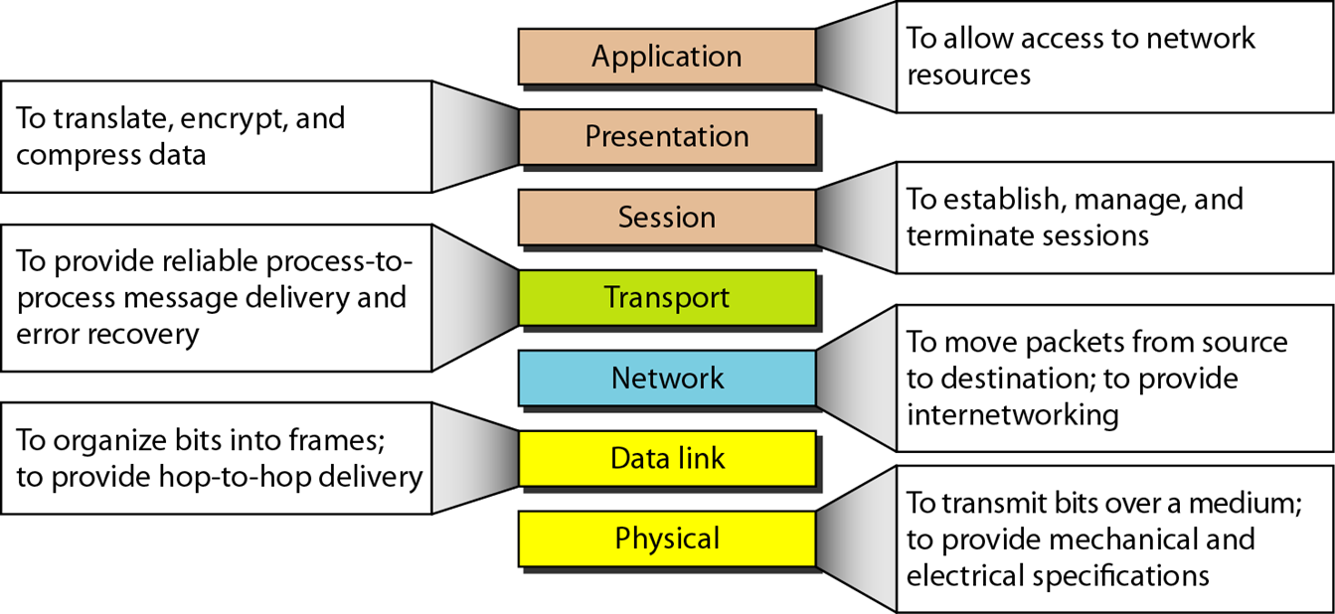

Slide 34
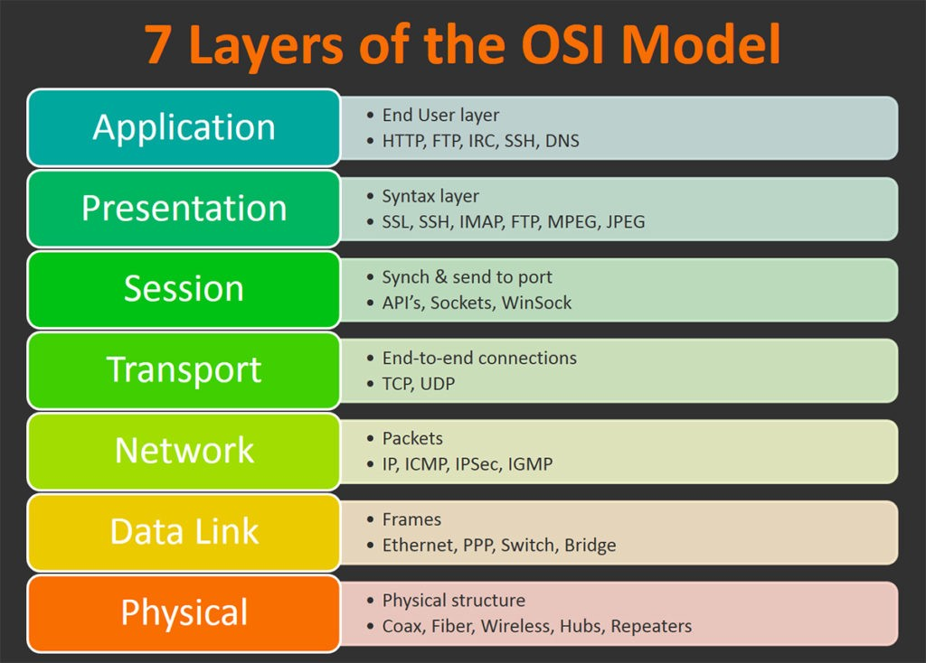

Slide 35
PDU’s And the OSI Model
Layer | PDU Name
7.) Application | Data
6.) Presentation | Data
5.) Session | Data
4.) Transport | Segment
3.) Network | Packet
2.) Data Link | Frame
1.) Physical | Bits
Decapsulation
Encapsulation

Slide 37
TCP/IP Protocol Suite
The layers in the TCP/IP protocol suite do not exactly match those in the OSI model.
The original TCP/IP protocol suite was defined as having four layers: host-to-network, internet, transport, and application.
However, when TCP/IP is compared to OSI, we can say that the TCP/IP protocol suite is made of five layers:
physical,
data link,
network,
transport, and
application.

Slide 38
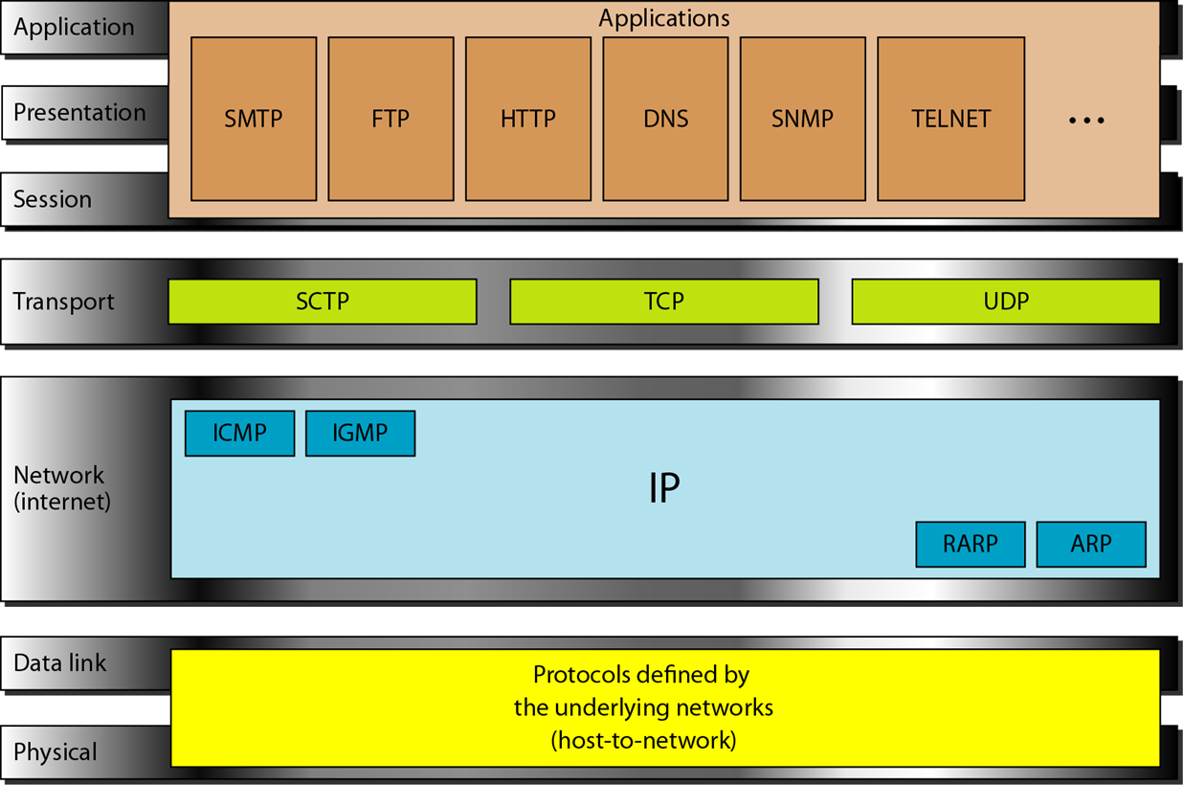

Slide 39
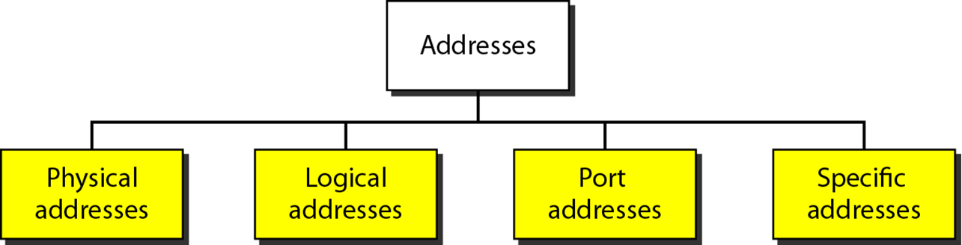
Addressing
Four levels of addresses are used in an internet employing the TCP/IP protocols:
physical (link) addresses,
logical (IP) addresses,
port addresses, and
specific addresses

Slide 40
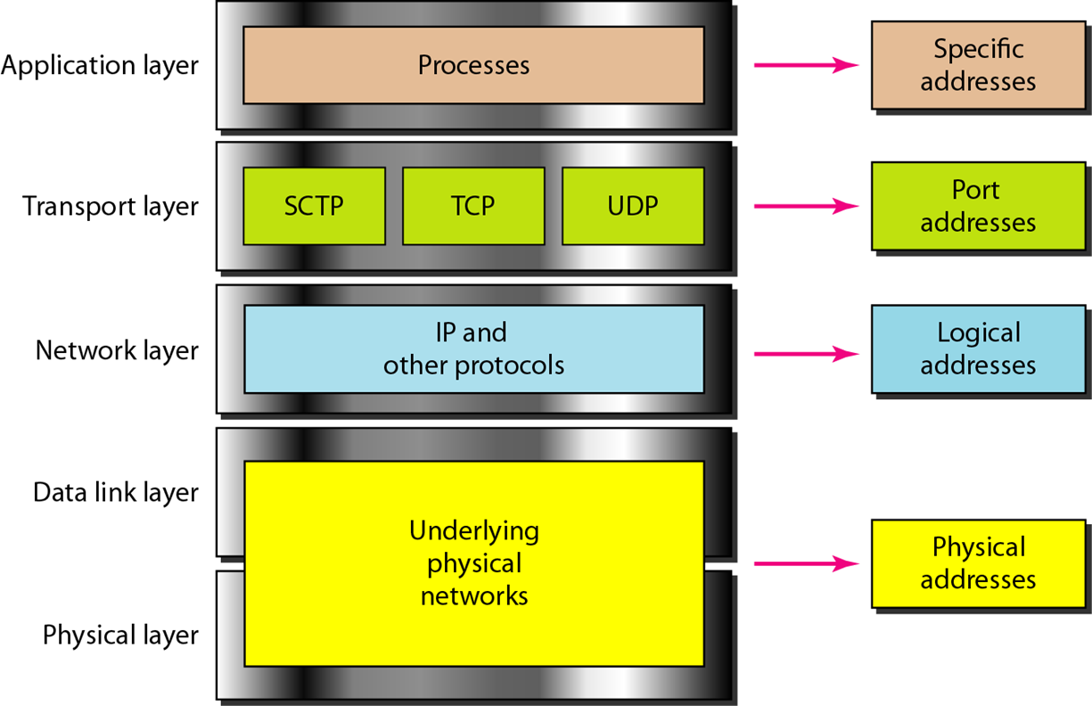
Notes:
Logical Address= IP Address
Physical Address= MAC address

Slide 41
Reading Assignment
Comparison between OSI and TCP/IP model.
Addresses and its types.
Different Addresses for different applications and networks.
Cmd-> ipconfig/all
Notes:
IP addresses changes with the change in network or sometimes after reconnecting or after a longer duration of time

Slide 42
References
https://www.studytonight.com/computer-networks/osi-model-network-layer#:~:text=Network%20Layer%20%2D%20OSI%20Model,across%20multiple%20links%20(networks).&text=It%20routes%20the%20signal%20through,acts%20as%20a%20network%20controller.
https://www.guru99.com/difference-tcp-ip-vs-osi-model.html#:~:text=OSI%20refers%20to%20Open%20Systems,both%20connection%2Doriented%20and%20connectionless.

